Slide 1

Controlling Player Avatars and Influencing Game Worlds Using Multi-Modal Input Systems

Slide 2
What does this mean!!!
My project aims to take in multiple forms of bio and physiological feedback and translate them into forms of input for a video game.
I would like to explore the act of using these inputs as ways to control humanoid virtual avatars and abstract events within the game.
Examples:
Controlling bone rig of avatar.
Movement of objects in space
Pulling and pushing global vector fields.
Magic systems.

Slide 3
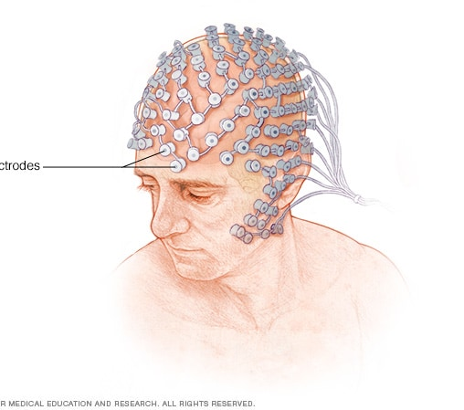
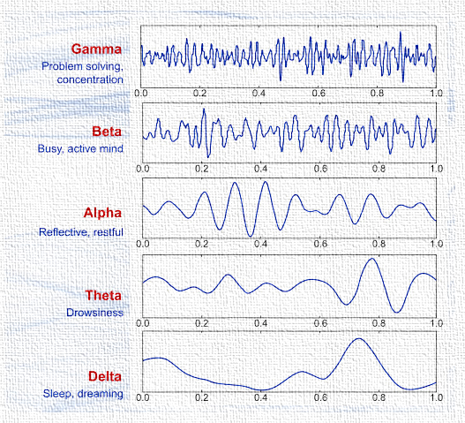
What is Electroencephalography (EEG)
Invasive (Surgical Implant) and Non-Invasive (Surface) sensors
Dry and wet sensors
ERP’s
Brain waveforms

Slide 4
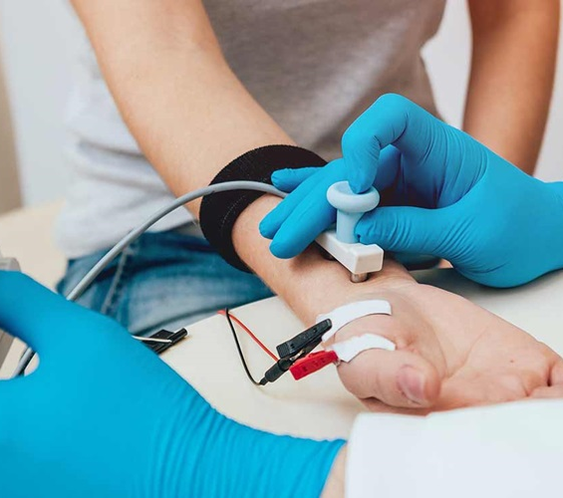
What is Electromyography (EEG)
Invasive (Needle) and Non-Invasive (Surface Sensor)
Motor Neurons -> Muscle Fibre -> Surface EMG

Slide 5
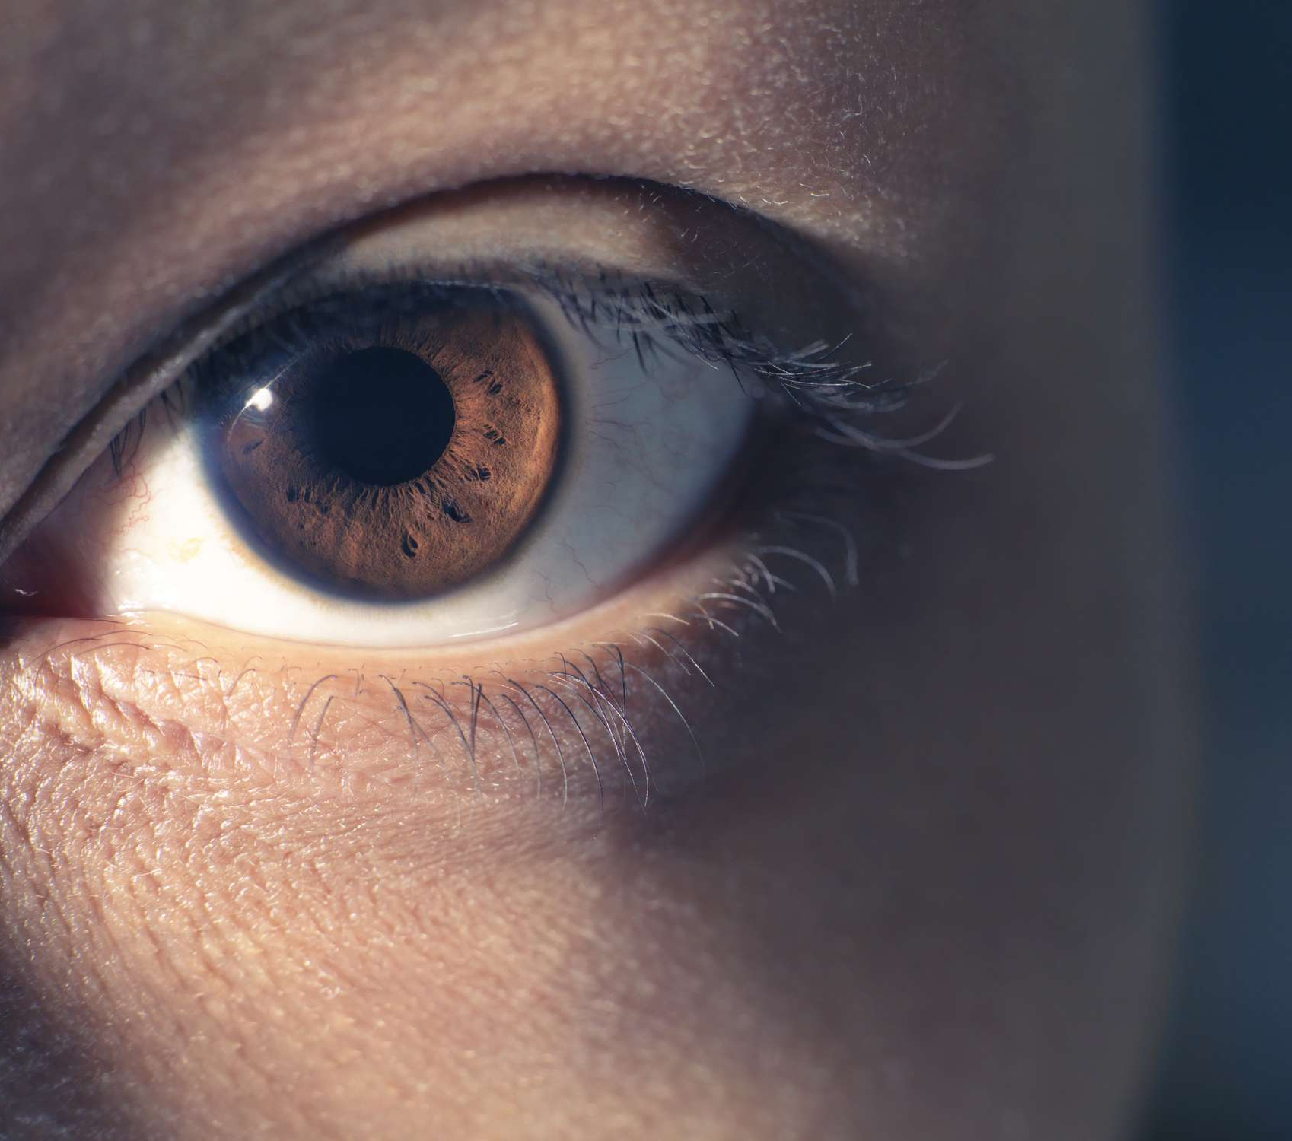
What is Eye-Tracking
Uses infrared light embitters and receivers to calculate the position of your gaze via the reflection in your eyes.

Slide 6
Why combine these methods?
Each method can give rise to different methods interaction.
When combined each method can give context to expand upon the others.
Another new method of game control
Wii
VR
AR

Slide 7
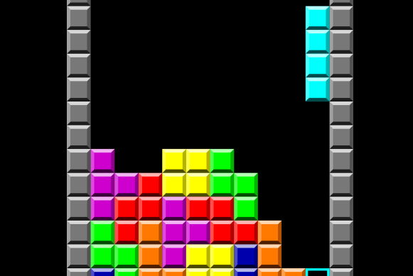
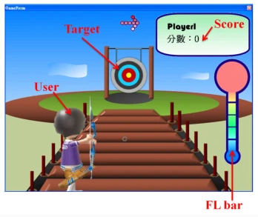
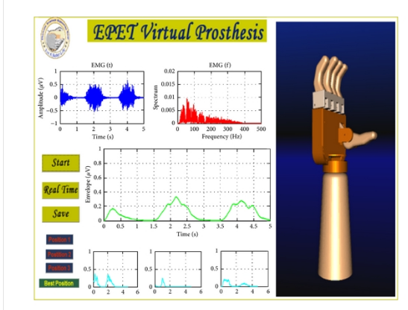
Similar works
Prosthetics
Focus based EEG games
Examining User Experiences through a Multimodal BCI Puzzle Game
Gaming control using a wearable and wireless EEG-based brain-computer interface device with novel dry foam-based sensors
https://ieeexplore.ieee.org/document/7272646
The Development of Body-Powered Prosthetic Hand Controlled by EMG Signals Using DSP Processor with Virtual Prosthesis Implementation
https://link.springer.com/article/10.1186/1743-0003-9-5
https://www.hindawi.com/journals/cpis/2013/598945/

